Slide 1


DWH PROJECT
ETL (SSIS) Package
Under Supervisior
ENG: Hazzam Omar
Abdullah Ibrahim Mahmoud

Slide 2

TOPICS
INTRO
Prepare Data Sources
ETL Package
Final tables in DWH
CODING
Final star schema
I 1

Slide 3
Introduction
The goal
create DWH in SQL server and then Implement an SSIS package solution to perform ETL to the "DW" server.
In My package contain full parameter like control flow , data flow and etc .DWH consists of the fact table to describe the aggregate function and number of dimensions to follow the describe it
.
I 2

Slide 4
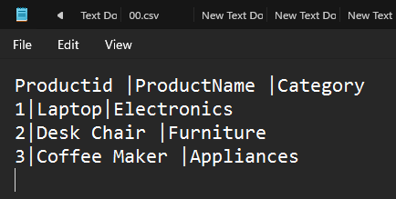
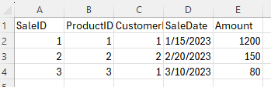

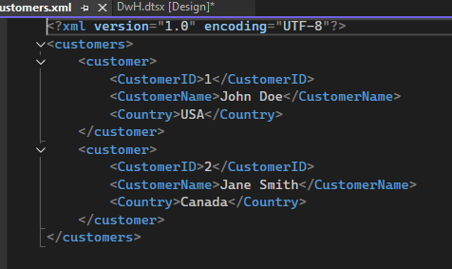
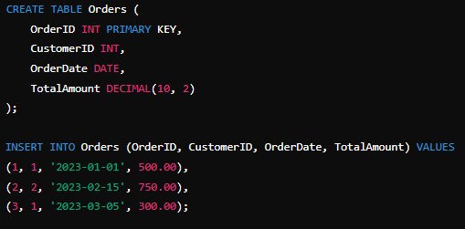
Prepare Data Sources
1. Text File (products.txt) 3. CSV File (sales.csv)
2. XML File (customers.xml) 4. Database Dump (orders.sql)
I 3

Slide 5
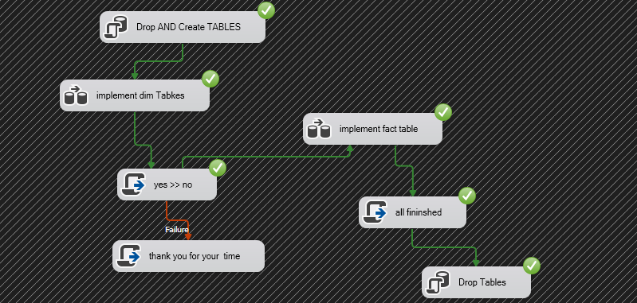
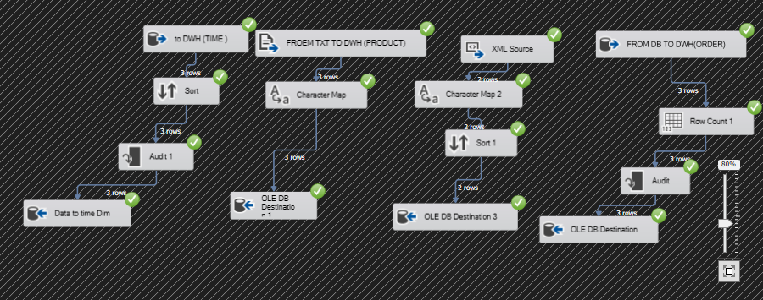
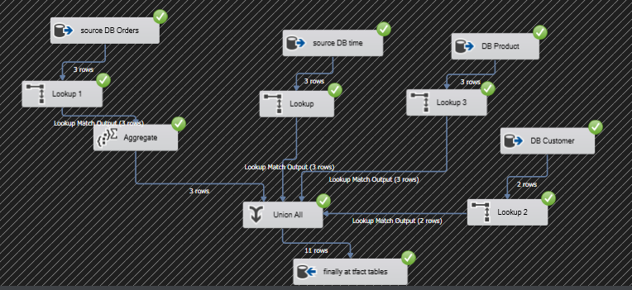
ETL Package
This photo
contain full parameter like control flow , data flow and etc
This photo
contain data flow one is Specialized at implement dimensions table
This photo
contain data flow two is Specialized at implement Fact table
I 4

Slide 6


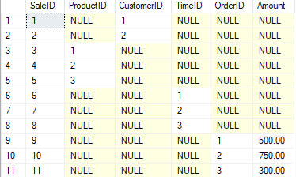


Final tables in DWH
ORDERs_Dim
Customers_Dim
SalesFact
Products_Dim
Time_Dim
I 5

Slide 7
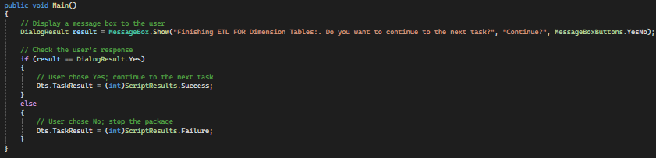


CODING
First C#
I 6

Slide 8
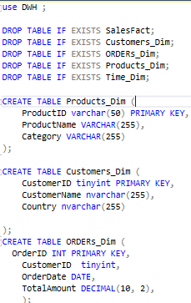
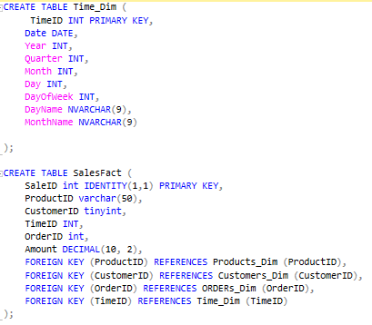
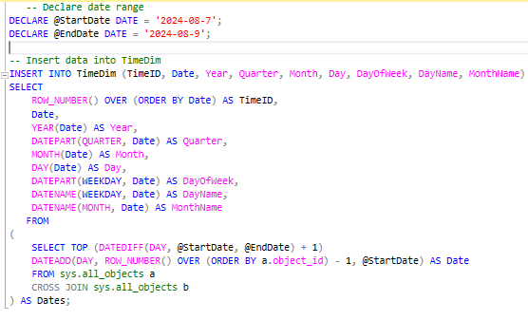
CODING
Second SQL
- - - - - - - - - - - - - - - - - - - - - - -
- - - - - - - - - - - - - - - - - - - - - - -
DML OF TABLES TO Give me Some Dates
DDL OF TABLES
I 7

Slide 9
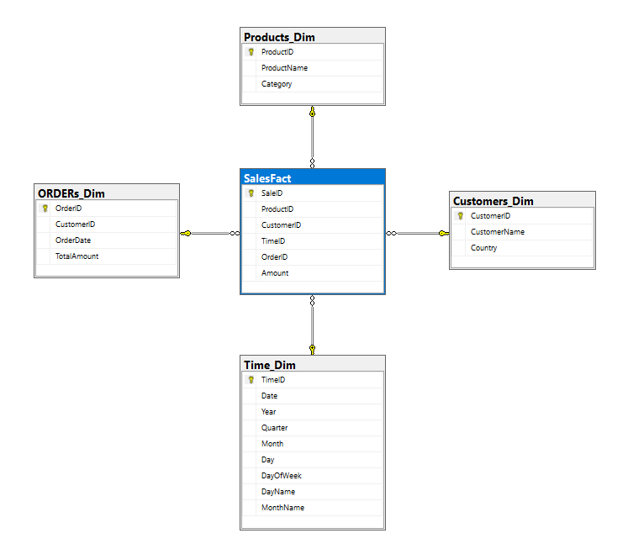


Final star schema
I 8

